Slide 1
Ministry Category : Government Of Goa.
Problem Statement :
The problem is to develop a web based application for colleges and the Directorate to keep track of Alumni.
Problem Code : DR111
Team Leader : Munagala Abhinav
Team Name : Alumni Titans
Title : Alumni Tracking System
College Code : 1-3513701229
OUR IDEA:
Our prior intention is that both the colleges and directorate can track alumni through their profile and posts.
To ensure security to user details.
Communication between alumni to alumni and with colleges.

Slide 2
OUR APPROACH:
When an alumnus register in this website, a verification request will be sent to respective college.
Once alumni are verified, they will be notified through the mail, subsequently they can login.
Alumni profiles will have privacy preferences, ensuring data security.
Secure Hash Algorithms(SHA) are used for password encryption.
Colleges and Directorate can search students, based on register number, graduation year ,college.
An interactive environment will be developed which contains chats, groups, events, notifications, remainders.
If the user is inactive for a long period, mails and messages will be sent to keep their profile updated.
Colleges are given ease to create feed back forms to take suggestions from alumni.
TECHNOLOGY STACK: HTML, CSS, JavaScript and Bootstrap, Python, Flask Framework, MongoDB

Slide 3
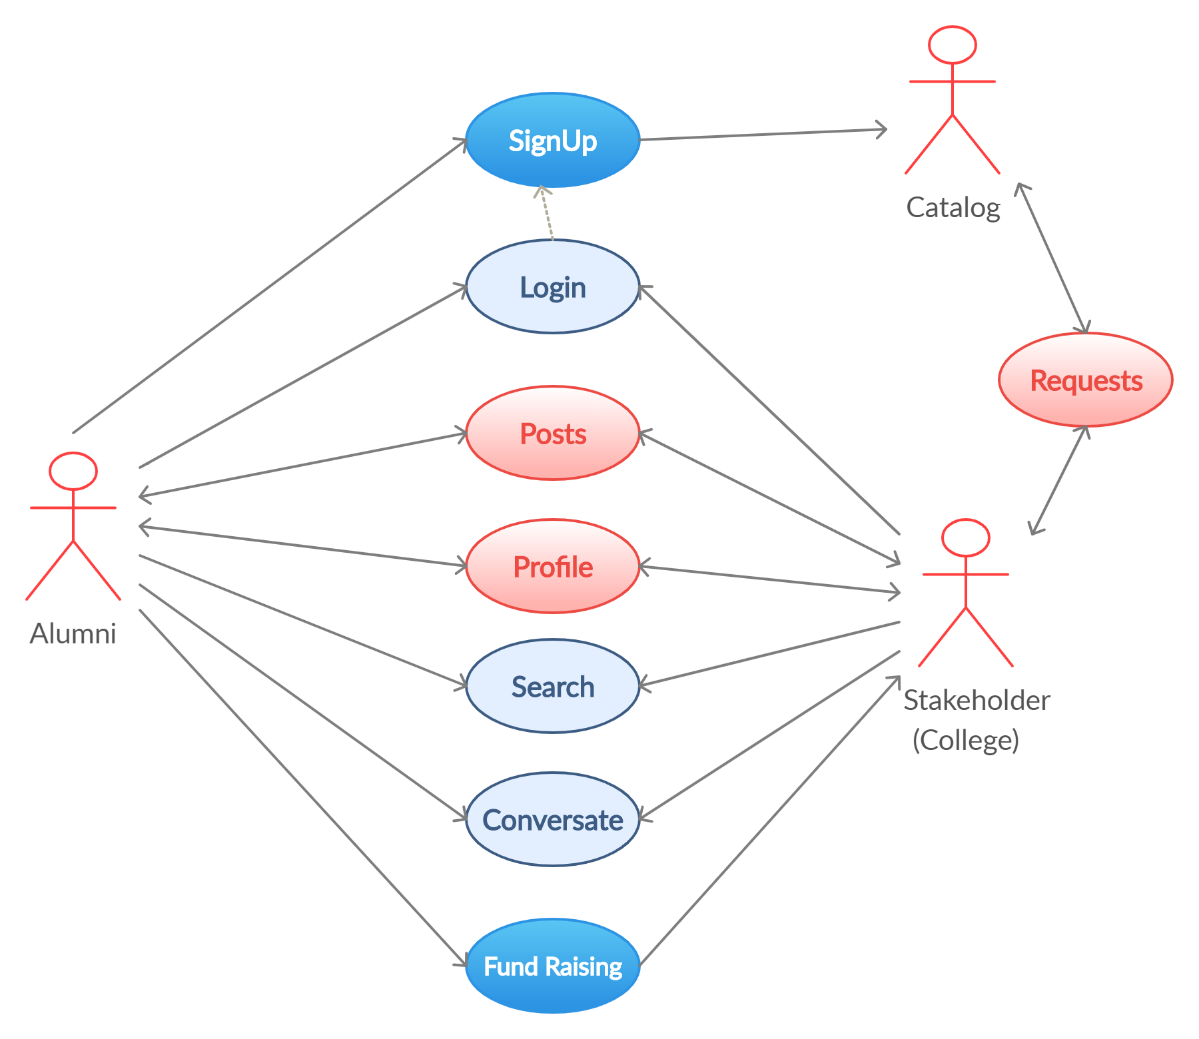
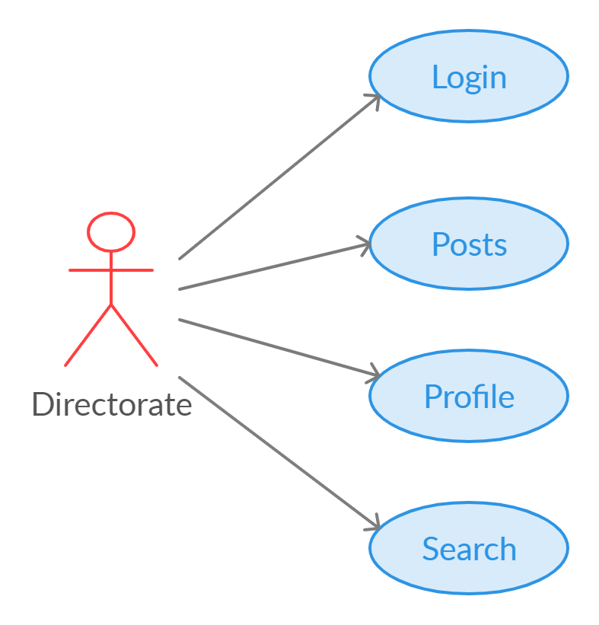
Use case :
alumni requests
can view
can view
Dependencies:
Flask package
pymongo package
smtp package
emailMessage package

